Slide 1
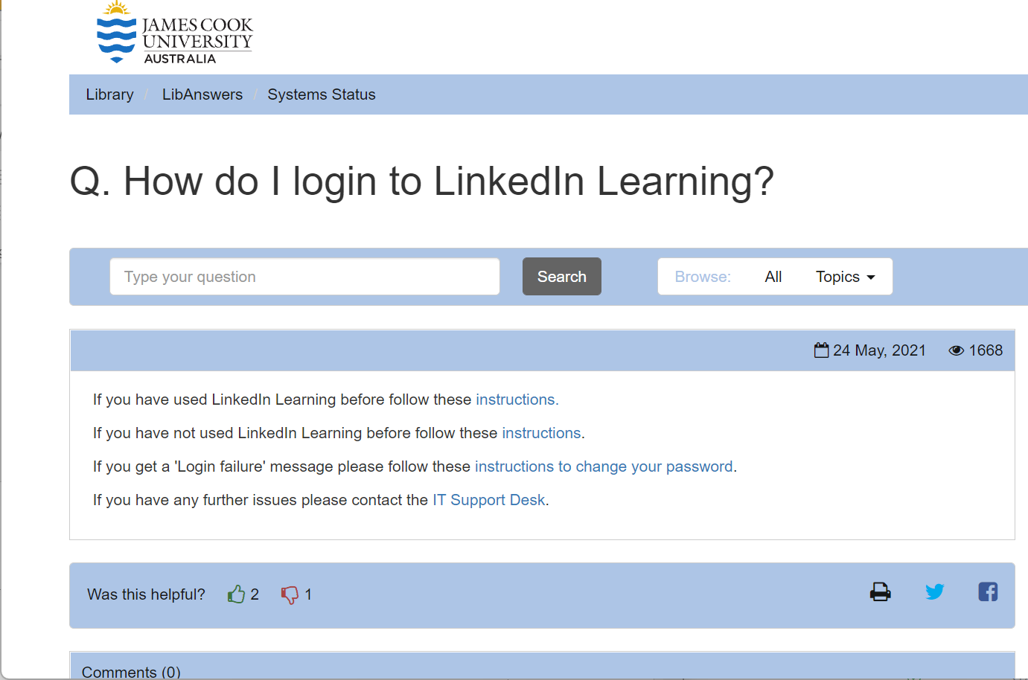
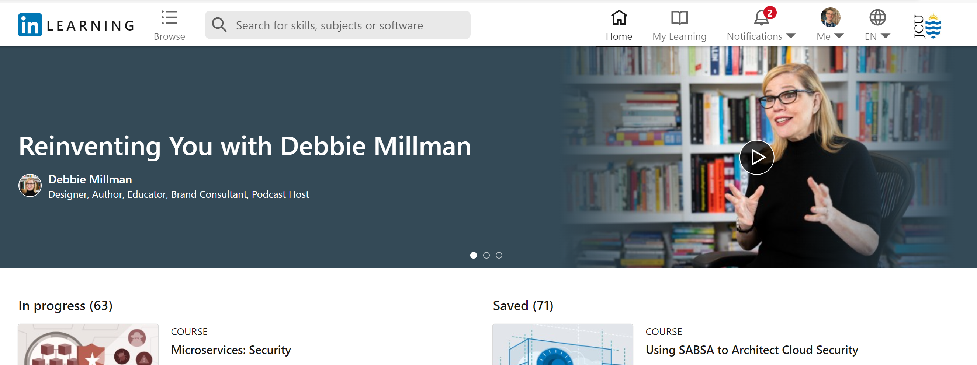
Create a personal LinkedIn account at www.linkedin.com
Follow instructions on the right to link your personal account with your JCU account
Search for “Figma Essential Training: The Basics“
How do I login to LinkedIn Learning? - LibAnswers (jcu.edu.au)
https://libanswers.jcu.edu.au/faq/264712

Slide 2
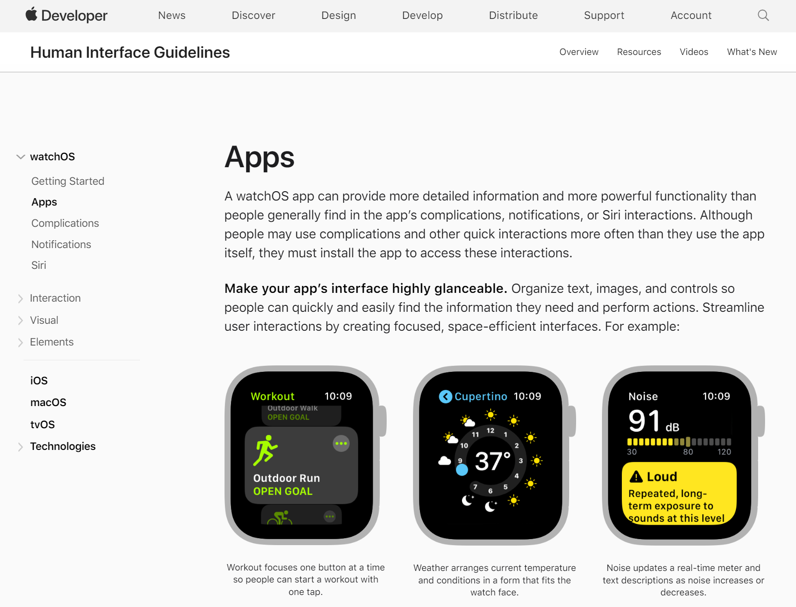
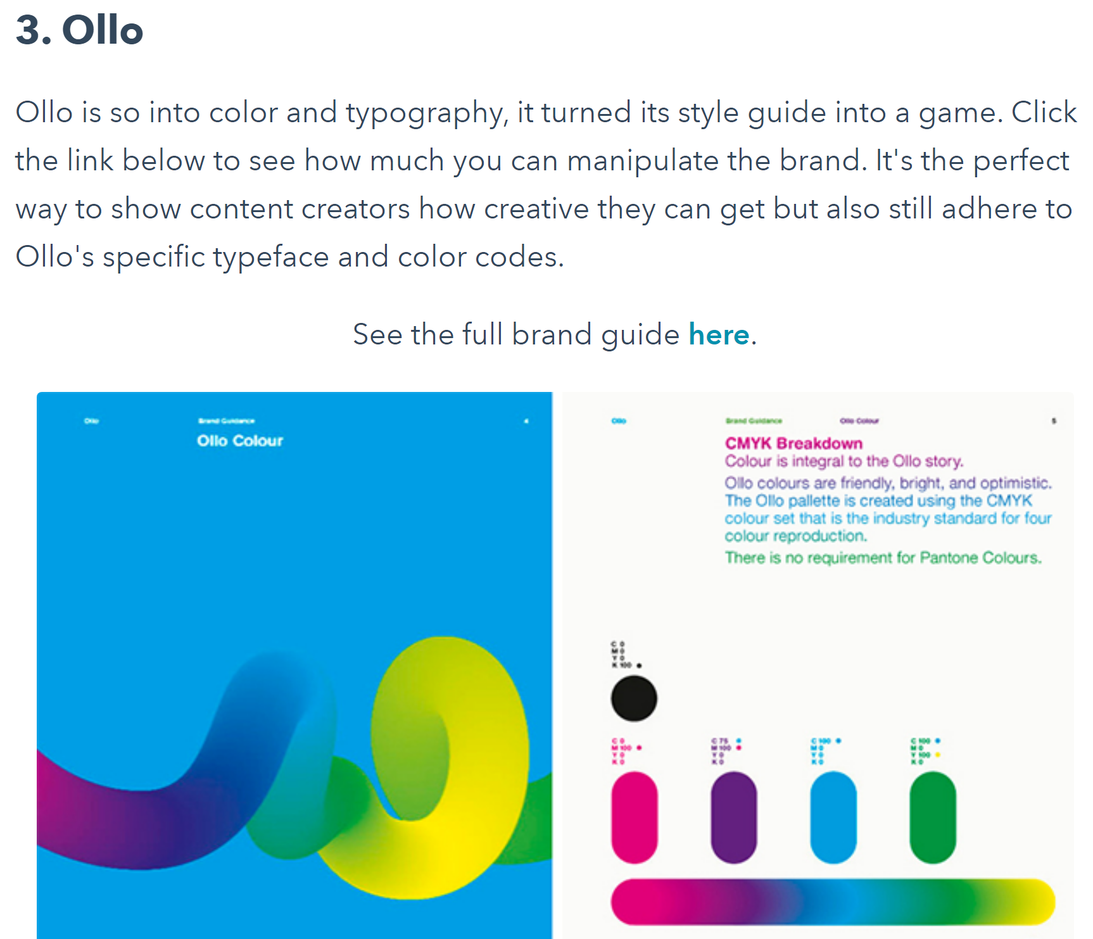
Guidelines
Platforms
Like: https://developer.apple.com/design/human-interface-guidelines/watchos/overview/apps/
Brands
Examples: https://blog.hubspot.com/marketing/examples-brand-style-guides

Slide 3
Group activity 1.3 (30 minutes)
Group design activity
Colours for a purpose
Your challenge is to select three colours main colours for an app design for:
Hospital / medical clinic (breakout groups 1, 6, 11)
Gym chain (breakout groups 2, 7, 12)
Supermarket (breakout groups 3, 8, 13)
High-end fashion brand (breakout groups 4, 9, 14)
Nature conservation association (breakout groups 5, 10, 15)
Use the mobile app and watch app templates to test your colours
Colour Tool: https://color.adobe.com/create/color-wheel

Slide 4







App Template
SIGN UP
LOGIN
SETTINGS
SOME FUNCTIONS
FIRST NAME
SOME CATEGORY
STATISTICS
ITEM 1
LAST NAME
ITEM 1
EMAIL ADDRESS
YOUR NAME
ITEM 1
USERNAME
PASSWORD
USERNAME
SOME CATEGORY
SESSIONS
ITEM 1
SIGN UP
**********
ITEM 1
ALREADY HAVE AN ACCOUNT?
SIGN IN
TWITTER
FACEBOOK

Slide 5
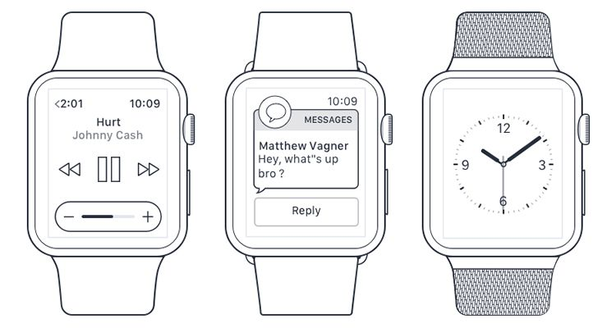







Watch Templates
10:09
<2:01 10:09
10:09
STATISTICS
SESSIONS
Hurt
Johnny Cash
MESSAGES
Jim M
Hey, how are you?
- +
Reply

